Slide 1

DATABASE DESIGN & MANAGEMENT
AFINA PUTRI DAYANTI - 825200049
PROGRAM STUDI SISTEM INFORMASI
UNIVERSITAS TARUMANAGARA

Slide 2
Distributed DBMSs – Concepts and Design
A multinational engineering company has decided to distribute its project management information at the regional level in mainland Britain. The current centralized relational schema is as follows:
Employee (NIN, fName, lName, address, DOB, sex, salary, taxCode, deptNo)
Department (deptNo, deptName, managerNIN, businessAreaNo, regionNo)
Project (projNo, projName, contractPrice, projectManagerNIN, deptNo)
WorksOn (NIN, projNo, hoursWorked)
Business (businessAreaNo, businessAreaName)
Region (regionNo, regionName)

Slide 3
Employee : contains employee details and the national insurance number NIN is the key.
Department : contains department details and deptNo is the key. managerNIN identifies the employee who is the manager of the department. There is only one manager for each department.
Project : contains details of the projects in the company and the key is projNo. The project manager is identified by the projectManagerNIN, and the department responsible for the project by deptNo.
WorksOn : contains details of the hours worked by employees on each project and (NIN, projNo) forms the key.
Business : contains names of the business areas and the key is businessAreaNo.
Region : contains names of the regions and the key is regionNo.
Departments are grouped regionally as follows:
Region 1: Scotland
Region 2: Wales
Region 3: England

Slide 4
Information is required by business area, which covers: Software Engineering, Mechanical Engineering, and Electrical Engineering. There is no Software Engineering in Wales and all Electrical Engineering departments are in England. Projects are staffed by local department offices. As well as distributing the data regionally, there is an additional requirement to access the employee data either by personal information (by Personnel) or by work related information (by Payroll).
22.15 Draw an Entity–Relationship (ER) diagram to represent this system.
22.16 Using the ER diagram from Exercise 22.15, produce a distributed database design for this system, and include:
a suitable fragmentation schema for the system
in the case of primary horizontal fragmentation, a minimal set of predicates
the reconstructionP of global relations from fragments

Slide 5
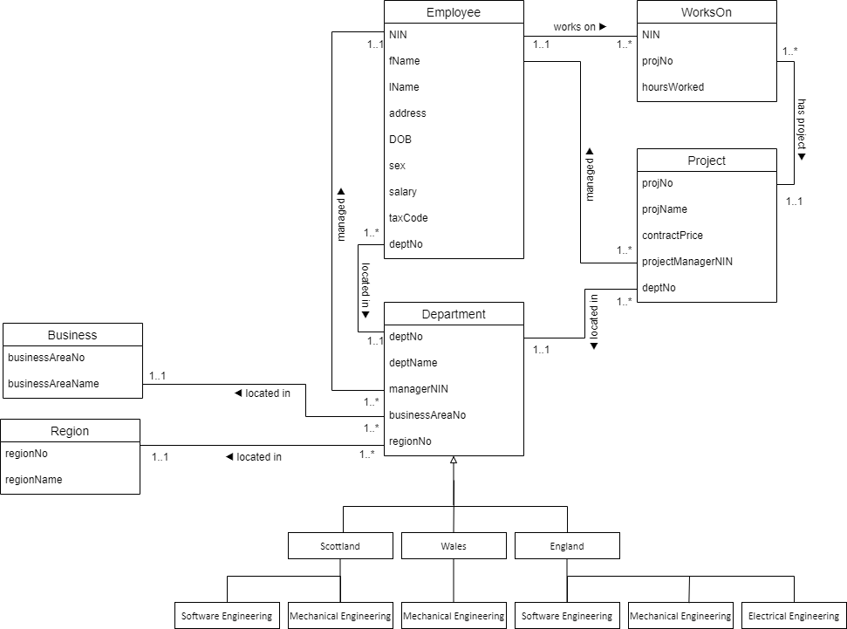
22.15 Draw an Entity–Relationship (ER) diagram to represent this system.

Slide 6
Department
Horizontal fragmentation can be achieved by selection operation
D1 Region = 'Scotland' and Business_area = 'SE’
D2 Region = 'Scotland' and Business_area = 'ME’
D3 Region = 'Wales' and Business_area = 'ME’
D4 Region = 'England' and Business_area = 'SE’
D5 Region = 'England' and Business_area = 'ME’
D6 Region = 'England' and Business_area = 'EL’
Reconstruction: D1 ∪ D2 ∪ D3 ∪ D4 ∪ D5 ∪ D6

Slide 7
Table Dummy
deptNo | deptName | managerNIN | businessAreaNo | regionNo
D001 | A | E001 | 1 | 1
D002 | B | E002 | 1 | 1
D003 | C | E003 | 1 | 1
Horizontal Fragmantation
D₁ = σ _{deptNo = ‘D001’}(Department)
deptNo | deptName | managerNIN | businessAreaNo | regionNo
D001 | A | E001 | 1 | 1

Slide 8
Employee
Use vertical fragmentation for Employee:
E1 : ∏ nin, first_name, last_name, address,b irth_date, sex, dept_no Employee
E2 : ∏ nin, salary, tax_code Employee
Then used derived fragmentation on fragment E1:
Eii : E1 ▷ dept_no Di 1 ≤ i ≤ 6
Reconstruction: (E11 ∪ E12 ∪ E13 ∪ E14 ∪ E15 ∪ E16 ) ⋈ nin E2

Slide 9
Table Dummy
NIN | fName | lName | address | DOB | sex | salary | taxCode | deptNo
E001 | Gigi | Hadid | UK | 23/04/1996 | F | 4000000 | 129L | D001
E002 | Selena | Gomez | US | 22/07/1992 | F | 2000000 | 190L | D002
E003 | Zayn | Malik | Bradford | 12/01/1993 | M | 6000000 | 109L | D003
Vertical Fragmantation
∏ nin, salary, tax_code Employee
NIN | salary | taxCode
E001 | 4000000 | 129L
E002 | 2000000 | 190L
E003 | 6000000 | 109L

Slide 10
Projects
Use derived fragmentation for Projects:
Pi : Projects ▷ dept_no Di 1 ≤ i ≤ 6
Reconstruction: (P1 ∪ P2 ∪ P3 ∪ P4 ∪ P5 ∪ P6 )
Table Dummy
projNo | projName | contractPrice | projectManagerNIN | deptNo
P001 | Proj A | 100 | E001 | D001
P002 | Proj B | 200 | E001 | D001
P003 | Proj C | 100 | E002 | D002

Slide 11
Derived Fregmentation
P₁ = σ _{deptNo = ‘D001’}(Project)
projNo | projName | contractPrice | projectManagerNIN | deptNo
P001 | Proj A | 100 | E001 | D001
P002 | Proj B | 200 | E001 | D001
Derived Fregmentation
P₂ = σ _{deptNo = ‘D002’}(Project)
projNo | projName | contractPrice | projectManagerNIN | deptNo
P003 | Proj C | 100 | E002 | D002

Slide 12
Works On
Use derived fragmentation for Works_on:
Wi : WorksOn ▷ nin E1i 1 ≤ i ≤ 6
Table Dummy
NIN | projNo | hoursWorked
E001 | P001 | 2
E001 | P002 | 5
E002 | P003 | 7

Slide 13
Derived Fregmentation
W₁ = σ _{NIN = ‘E001’}(Works On)
NIN | projNo | hoursWorked
E001 | P001 | 2
E001 | P002 | 5
Derived Fregmentation
W₂ = σ _{NIN = ‘E002’}(Works On)
NIN | projNo | hoursWorked
E002 | P003 | 7

